Slide 1
Breast Cancer Predictions
By: Beatriz Ruiz, Gabriela Cortes, Sana Shaikh, Pavit Chawla, Abubakir Siedahmed
Notes:
Beatriz (4)

Slide 2
Introduction
The goal of our project is to predict breast cancer by applying our machine learning knowledge to use different algorithms and compare accuracy results.

Slide 3
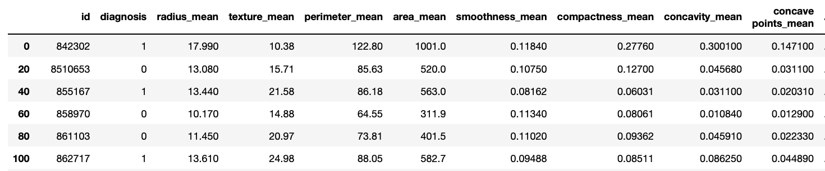
Data Set
We are using a data set from kaggle
https://www.kaggle.com/uciml/breast-cancer-wisconsin-data
Used all features provided
Assigned the diagnosis as our label
1 = malignant, 0 = benign

Slide 4
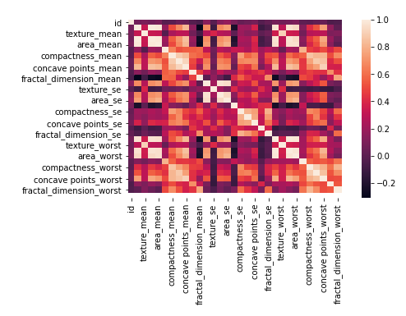
HeatMap
Heatmap of all features in dataset
Notes:
We wanted to include a heatmap of all of our features as another visual to better understand how all of our features would correlate with each other and to visualize the behavior of the features even though in our model we did not do any feature selection.

Slide 5
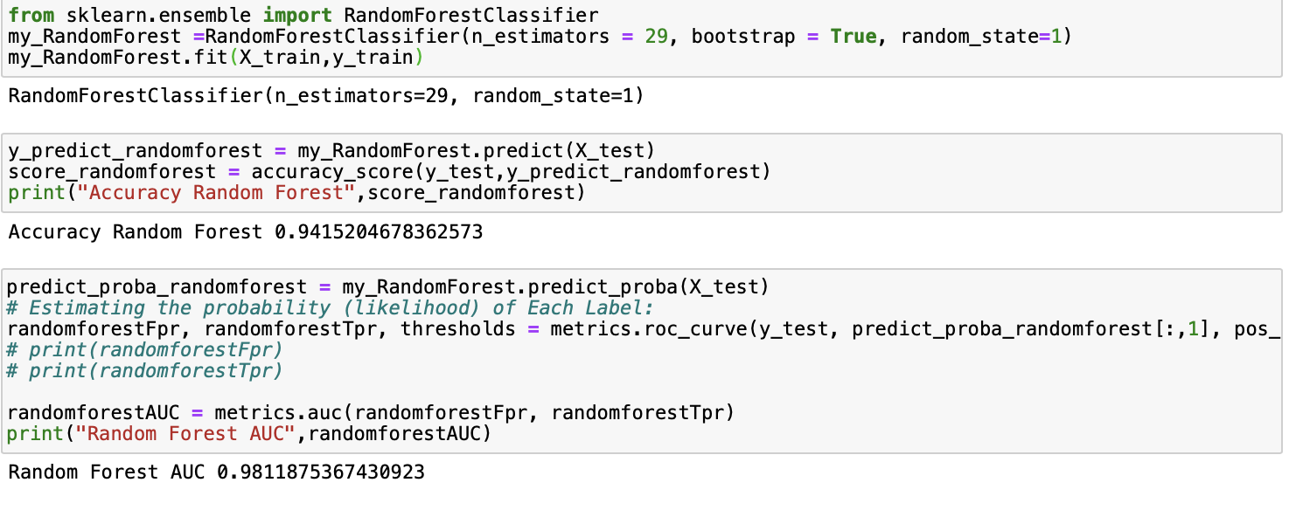
Random Forest
Used Random Forest to find the accuracy which is: 94% with n_estimators=29
Used 1 as random state and 0.3 as testing size

Slide 6
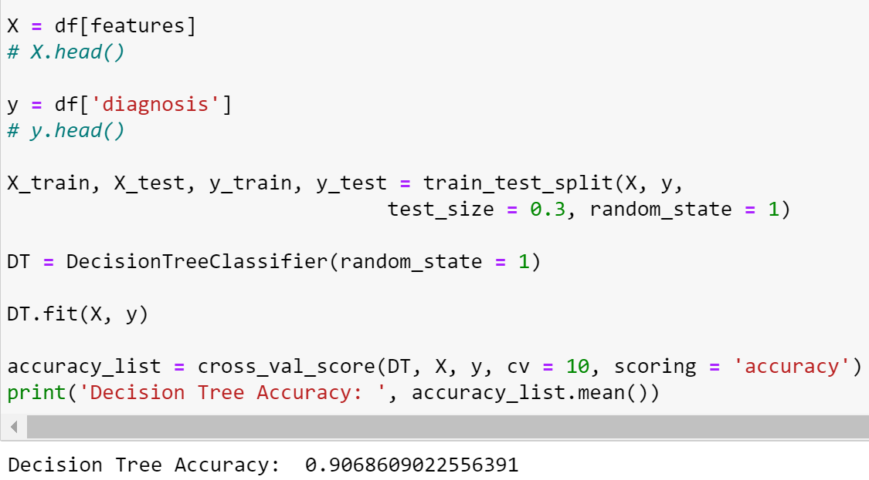
Decision Tree
Accuracy for Decision Tree is 90%
Used 1 for the random_state
Used 10-Fold Cross Validation

Slide 7
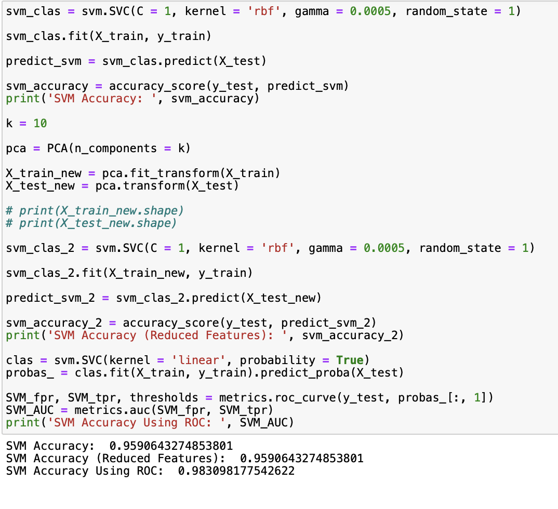
SVM and PCA
Used SVM to find the accuracy which is 95%
Set gamma to 0.0005
Used PCA to reduce the dimensionality to 10
Accuracy remains the same
K is 10
30% of the data was used during the testing stage and 70% was used during the training stage
Initiated random_state to 1

Slide 8
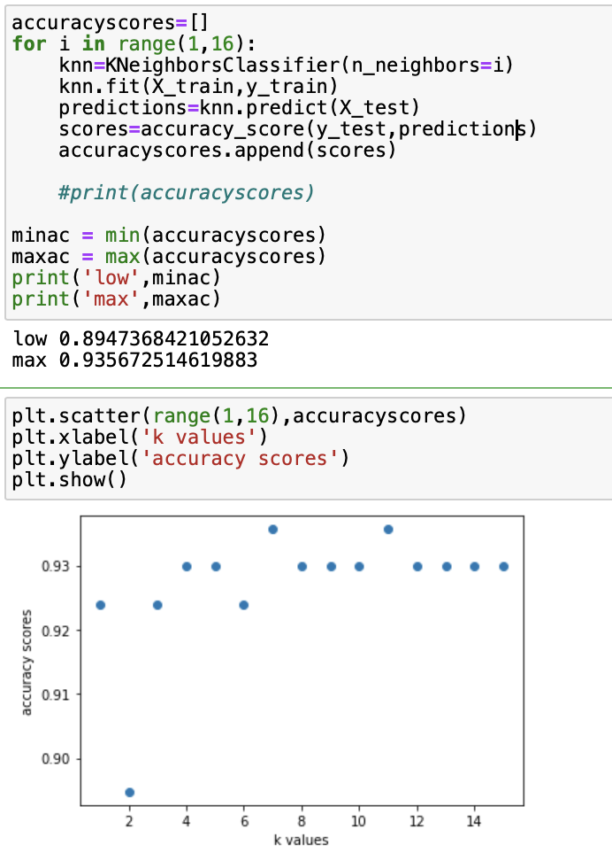
KNN
Test_size was set for 30% of the data and Random_state was set to 1.
We chose to predict accuracy scores from the range for k values
The top score being 93% and the lowest score being 89%
Notes:
KNN is a supervised machine learning algorithm. For this algorithm we decided to choose a range of 15 for our predictions in order to see which value would give us the highest accuracy. We set the test size to be 30% of the data as we did with our other algorithms and set the random state to 1. What we saw from this algorithm is that our as our k values increased, the accuracy almost stayed constantly at 93%.
We picked a random state as 1 to make sure that no matter how many times we execute our code, the result will be the same every time. https://stackoverflow.com/questions/42191717/scikit-learn-random-state-in-splitting-dataset

Slide 9
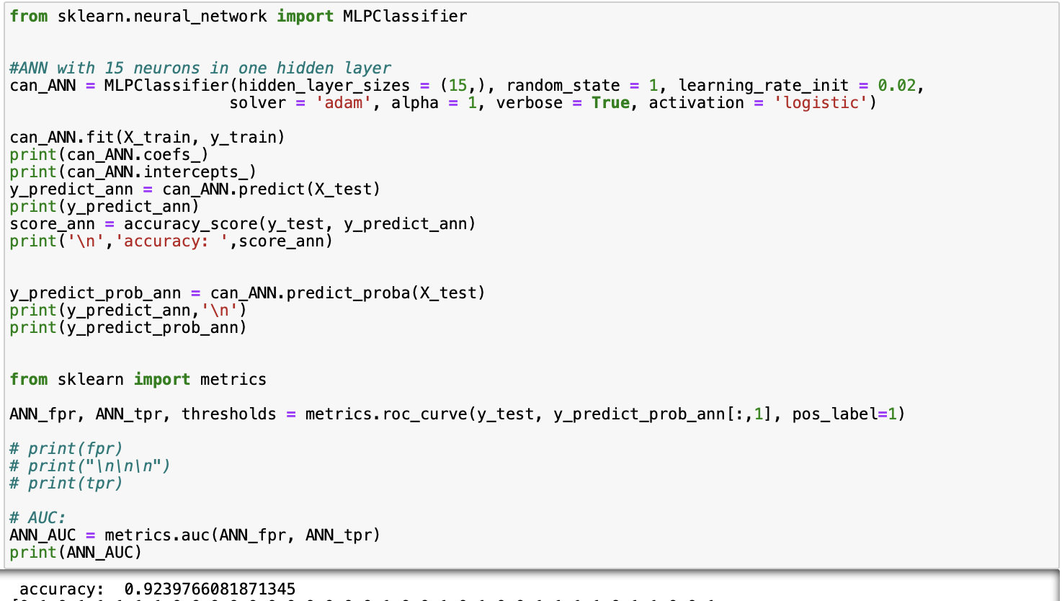
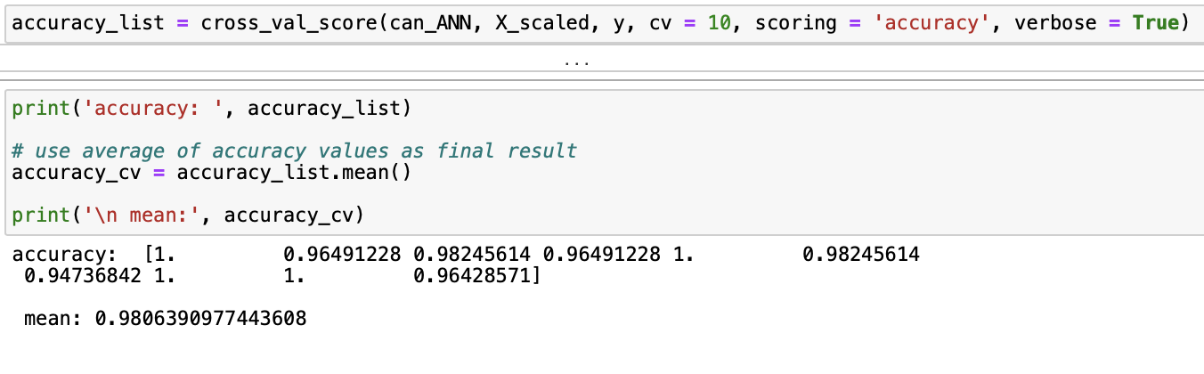
ANN
ANN with 15 neurons in one hidden layer, and random_state 1
Tried with different number of neurons and accuracy score was highest at 15 and 60 neurons
Used 10-fold Cross Validation with normalized features to evaluate the model
Accuracy for ANN before CV is 92% and after CV is 98%.
Notes:
Tried ANN with 3 hidden layers, each with different number of neurons but the accuracy score remained low. Then I tested different number of neurons with just one hidden layer and noticed the accuracy score was highest with only one hidden layer and remained the same for 15 and 60 neurons, at 92%. All other number of neurons gave a slightly lower accuracy score.

Slide 10
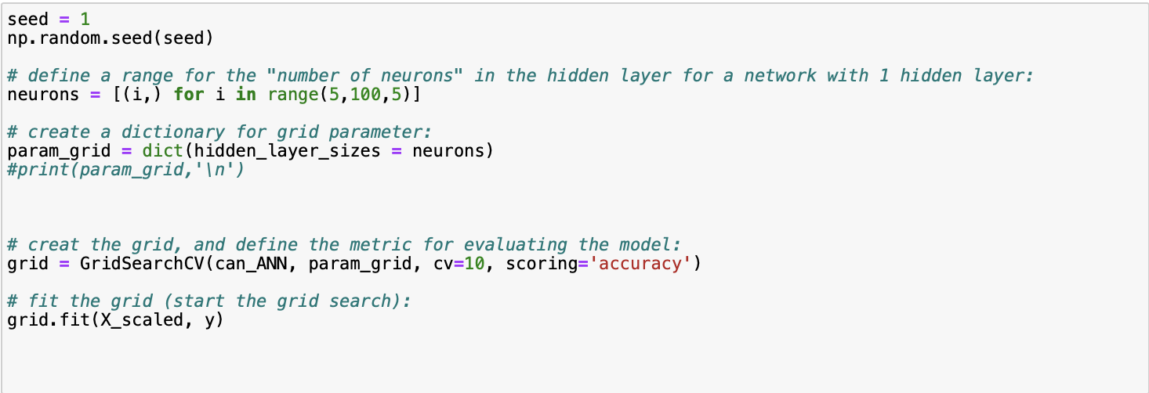
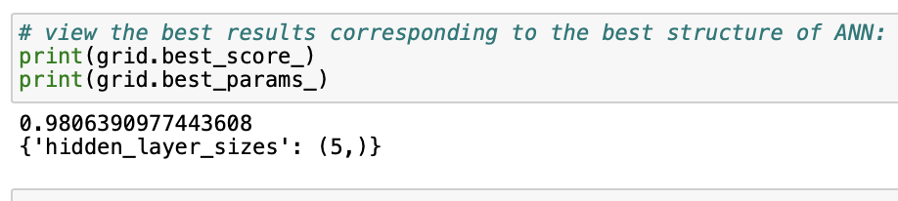
GridsearchCV
Implemented numpy random seed function by setting the seed to 1 for reproducibility.
Set a range from 5 to 100 to search for the best number of neurons with step size of 5, in a hidden layer of 1.
Created a param_grid dictionary with hidden_layers set to our neurons we set
Implemented GridsearchCV to evaluate ANN model and fit the grid to start the grid search with the scaled features and label.
The best score we got was 98% and the best hidden layer size was 5.
Notes:
Gridsearch is a function that comes in Scikit-learn model selection package. This function helps to loop through pre-defined hyperparameters and fit the ANN model estimator on our training set to determine the best score and best parameters to use. We set a range of 5 to 100 to search for the best number of neurons in a hidden layer of 1. After creating our dictionary and setting our neurons for sequence searching we created the grid to evaluate our ANN model and set the cross validation splitting to 10 we found that our best hidden layer was 5 and that our accuracy was 98%

Slide 11
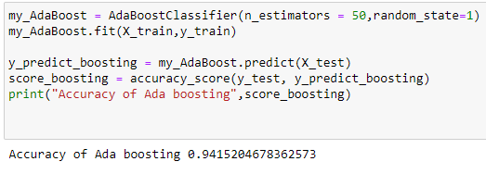
AdaBoost
Implemented using n_estimators of 50 and a random state at 1
Accuracy of AdaBoosting: 94%
Notes:
Gaby
We also implemented a scikit learn Adaboost classifier with a test size of 30, 50 n-estimators, a random state of 1 and got an accuracy of 94%

Slide 12
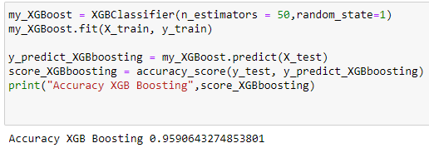
XGBoost
Implemented using n_estimators of 50 and a random state at 1
Accuracy of XGBoosting: 95%
Notes:
Gaby
Then we implemented an XGBoost classifier with the same values as the adaboost classifier to compare and we got a slightly higher accuracy of 95%

Slide 13
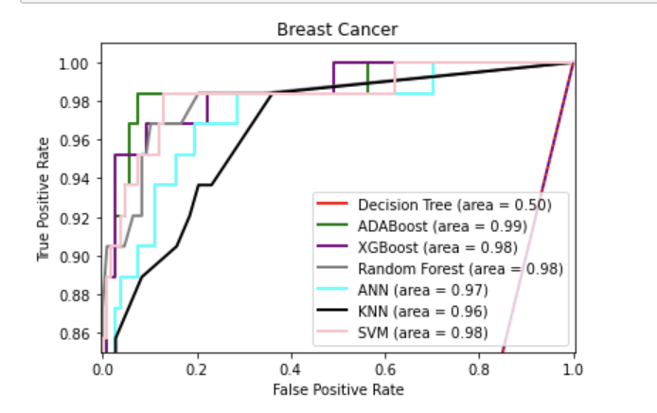
ROC Curves
Had to modify the dataset: Malignant: 1, Benign: 0 to plot ROC curves
Implemented ROC curves for seven algorithms: Decision Tree, ADABoost, XGBoost, Random Forest, ANN, KNN, and SVM
Notes:
Pav

Slide 14
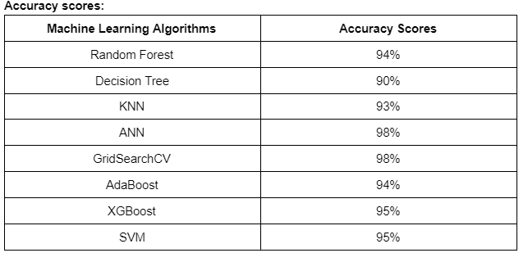
Best Algorithm for our prediction
The best algorithms for our prediction are Artificial Neural Network (ANN) and GridSearchCV at 98% accuracy
Notes:
Pav

